Slide 1
Recurrence of Abnormal Valuation factor
-JIE

Slide 2
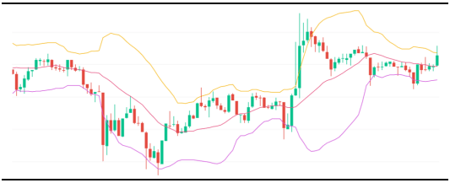

Traditional Bollinger Bands Strategy
Assume return obeys Geometric Brownian Motion

Slide 3



PE ratio is actually a simple version of DCF model:
We use the net profit to represent the cashflow and it has a permanent growth:
Reasonable valuation level:

